Slide 1
Citi Bike Data Analysis
By Pranav Dharpure

Slide 2
Project Goal:
To better understand the behavior of NY Citi Bike’s customer base (both one-time users and subscribers) and how they use NY Citi Bikes
This will help us to:
Identify where more bikes should be installed
Create targeted marketing campaigns that will appeal to different customer segments

Slide 3
Key questions:
What are the most popular pick-up locations across the city for NY Citi Bike rental?
How does the average trip duration vary across different age groups?
Which age group rents the most bikes?
How does bike rental vary across the two user groups (one-time users vs long-term subscribers) on different days of the week?
Does user age impact the average bike trip duration?

Slide 4
Findings & Insights

Slide 5
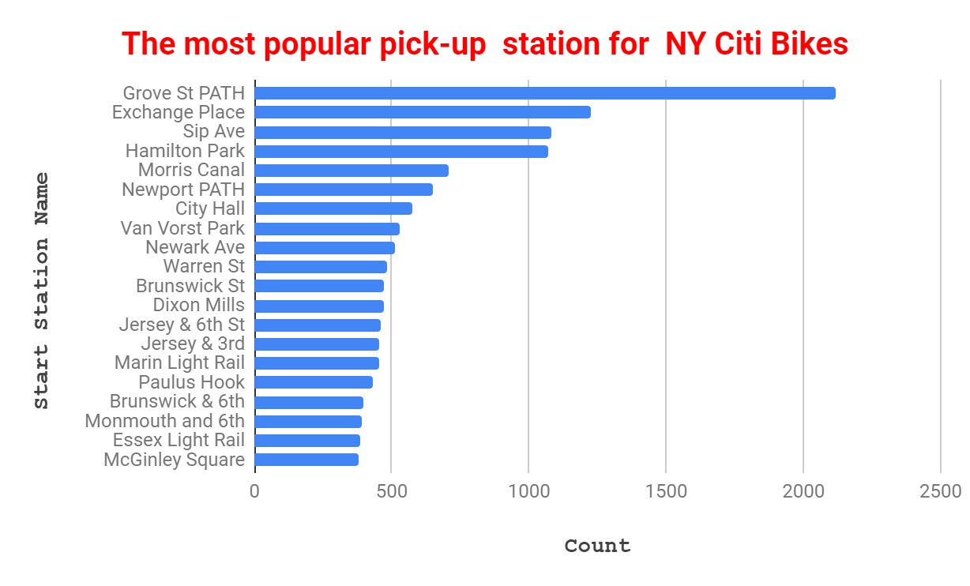
What are the most popular Citi Bike pick-up locations?
Grove St Path, Exchange Place, Sip Ave, Hamilton Park, Morris Canal, Newport Path, City Hall, Van Vorst Park, Newark Ave and Warren St are the most popular pick-up stations.

Slide 6
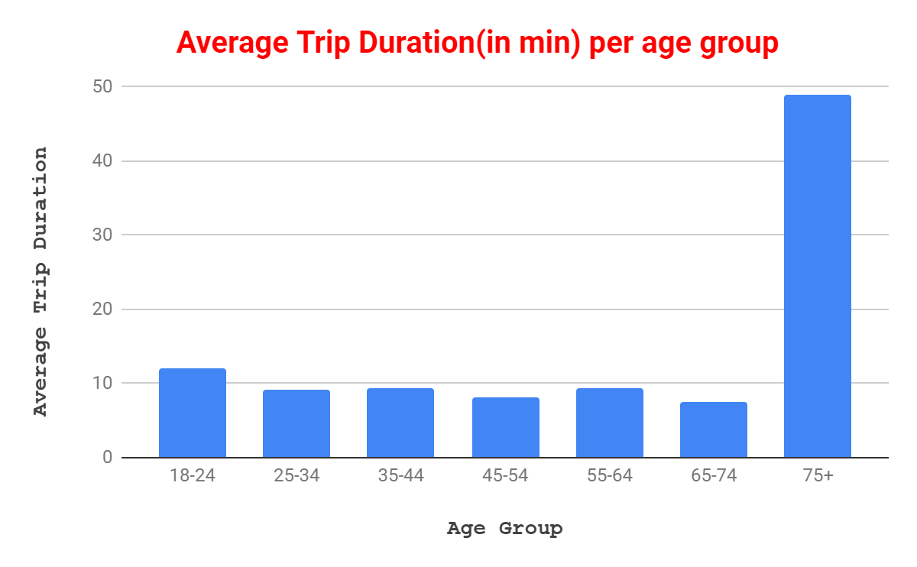
2. How does the average trip duration vary across different age groups?
75+ year olds take the longest trips (on average)
65-74 and 25-34 year olds take the shortest trips (on average)

Slide 7
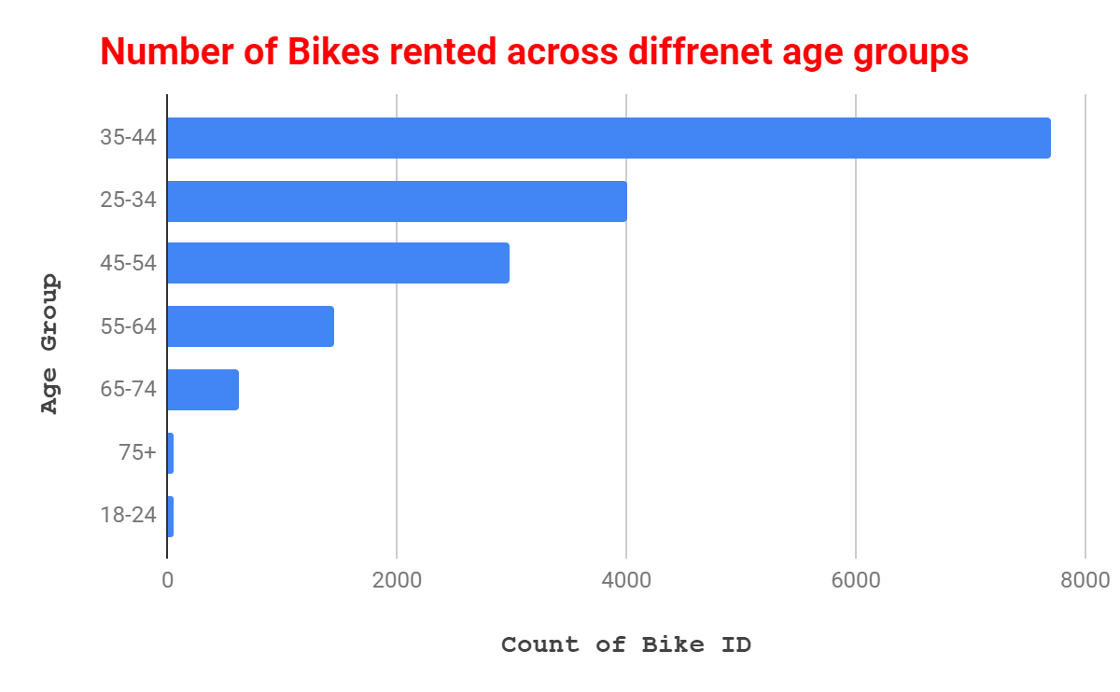
3. Which age group rents the most bikes?
35-44 year olds rent the most bikes
75+ and 18-24 year olds rent the least bikes

Slide 8
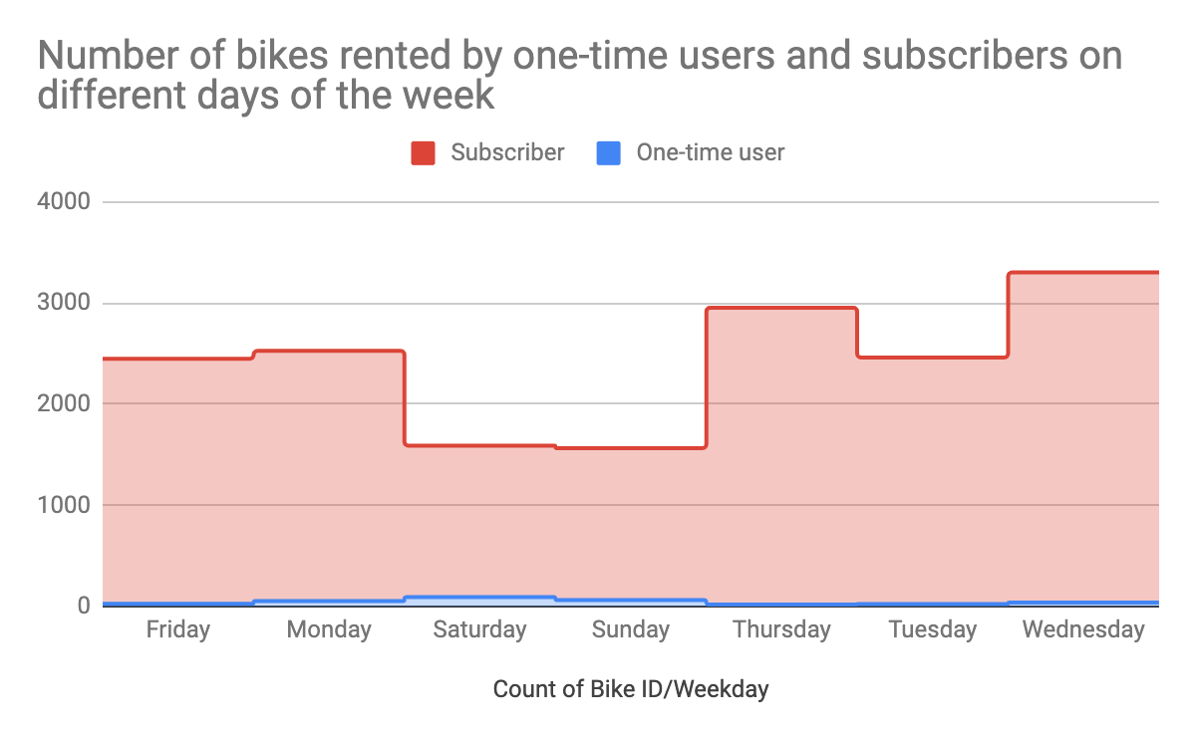
4. How does bike rental vary across the two user groups (one-time users vs long-term subscribers) on different days of the week?
Citi Bike customer base is predominantly made up of long-term subscribers
Subscribers are more active during the week
One-time users are more active on weekends

Slide 9
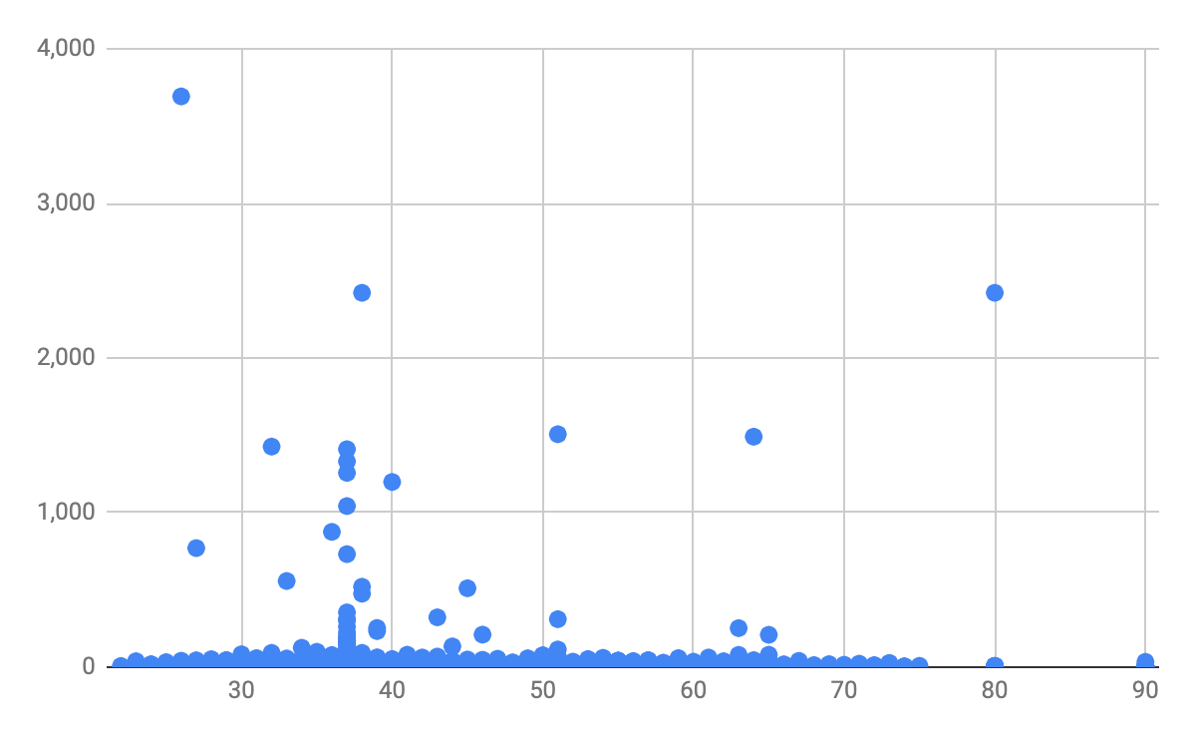
5. Does the factor of age impact the average bike trip duration?
No relationship between user age and trip duration

Slide 10
Summary

Slide 11
Summary of findings:
Top 5 pick-up locations for bikes:
Grove St Path, Exchange Place, Sip Ave, Hamilton Park, & Morris Canal
Customer base:
Mostly long-term subscribers who are more active during the week
One-time users more active at weekends
Most bikes rented by 35-44 year olds
Citi Bike customer behavior:
75+ year olds take longest average trips, but rent the least bikes
65-74 and 25-34 year olds take the shortest trips on average

Slide 12
Actions & Recommendations

Slide 13
Recommended actions:
Product recommendations:
Install more bikes at Grove St Path, Sip Ave, Newport Path, Newark Ave, Van Vorst Park.
Marketing recommendations:
The Citi Bike customer base is mostly long-term subscribers aged between 35-44, who are most active during the week. This tells us that they are probably people who live in New York and use NY Citi Bikes to commute. Marketing and advertising campaigns should therefore target this particular demographic.

Slide 14
Thank you!

